Slide 1

Department of Management
Faculty of Commerce & Management
Vishwakarma University, Pune
Mini Project Synopsis
“Campus placement and recruitment system”
Guide Name : Dr.Prof.Mr. Yogesh Desale
Student Name 1 : Shaikh Shahid
Student Name 2 : Shruti Jain
Student Name 3 : Shantanu Roy
Student Name 4 : Shraddha Jadhav
Student Name 5 : Srushti Khapare
Student Name 6 : Hrishikesh Shinde

Slide 2
AIM OF THE PROJECT
This paper presents a Campus Recruitment System that consists of a student login, company login and admin login..
This is like a monitoring system where admin can monitoring Student profile.
This system allows the student to create their profiles and upload all their details including theirmark sheets to their campus recruitment profiles
The admin only can check each student details and also can monitor their student’s campus_ details.
Student have app to access the job opening and selected job positions updates.

Slide 3
OBJECTIVE OF THIS PROJECT
Campus Recruitment Management system is helpful for the companies which are in need of employees, students who are in need of job.
This portals main aim is to provide the vacancies available for the students.
CR’S(Company) will automatically send mails to all students whose skills are matched with the requirement.
The primary objective of campus recruitment is to identify and hire potential candidates who possess the necessary skills, knowledge, and qualifications to meet the organization's workforce needs.
The Secondary objective of campus recruitment is to help College managing/ Maintanance of Recruitment and Placement .

Slide 4

SOFTWARE AND HARDWARE REQUIREMENTS
HARDWARE REQUIREMENTS:
Processor : Intel 3
Motherboard : Intel mother board – VTx Enabled
Ram : 4 gb
Hard disk drive : 500 gb
SOFTWARE REQUIREMENTS:
Front end : html5, css3.
Back end : php, mysql.
Control end : angular java script
PHP Tools:
xampp-win32-5.5.19-0-VC11

Slide 5
EXISTING SYSTEM
The existing system is built with numberless excel sheets that are created by each user.
The job recruits graduates by maintaining manual records which involves many loop holes.

Slide 6
DISADVANTAGES OF EXISTING SYSTEM
1.Lack of privacy​
2. Redundancy: Manual records tend to contain data which are redundant. This is because Normalization followed is consistent data base is missing feature in manual records.
3. Inconsistency: Because of redundant data, there is no consistency in the data.
4. Time Consuming: Maintaining each students and employees data with much number of fields is a tedious process and takes more time to retrieve back.
5. Improper Validation: There are many cases where validation is to be performed between the existing data and yet to be entered data. Also, a graduate who appears for the interview and fails to succeed should not be reconsidered until a period of 3 months
6. Tedious: An organization data base goes through many numbers of updates each day which is hard to maintain in registers.

Slide 7
PROPOSED SYSTEM
The proposed system will be web based applications so it can be accessed by company and students with the help of admin.
The two main users are
1. Student
2. Administrator
student is the one who is looking for a job in the same organization who can be a fresher or an experienced.
After entering all the details, the students can view a page containing all the vacancies available.
students can now apply to one or any number of jobs whose interview details are later intimated by the Administrator

Slide 8
ADVANTAGES OF PROPOSED SYSTEM
It is very easy to manage historical data in database.
There will be no need of putting up notice or emailing every student about the company coming in college. The students can keep updated themselves through this software.
The company can view all students’ detail and system can shortlist students according to their criteria instead of doing manually.
There is admin login that can view and manage both students and company’s account and also can put up notifications.
Student can register online instead of going to placement department for registration.
This system saves time and efforts.

Slide 9
MODULE LIST
Project
Administrator
Job Seekers (Students)
Placement staff

Slide 10
MODULE LIST
ADMIN
Login
Provide approval
Search records
Student Details (Approved and Rejected)
Company Details with Job Opening (Criteria and Student Applications)
Overall Control (Students and Company)

Slide 11
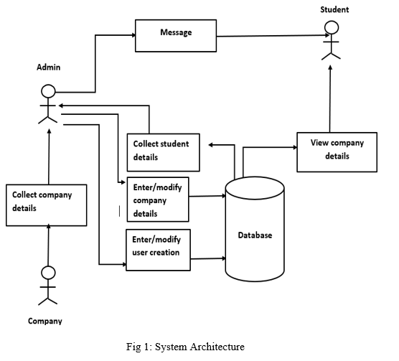
DIAGRAMS
ARCHITECTURE DIAGRAMS

Slide 12
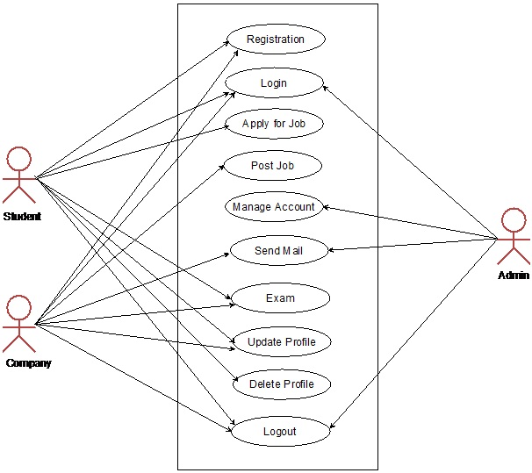
USECASE DIAGRAMS
Company
Student
Admin

Slide 13
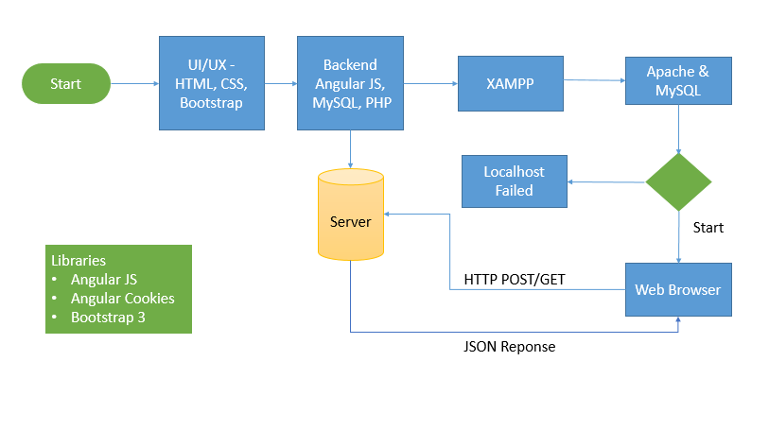
WORKFLOW DIAGRAM FOR WEB APPLICATION

Slide 14
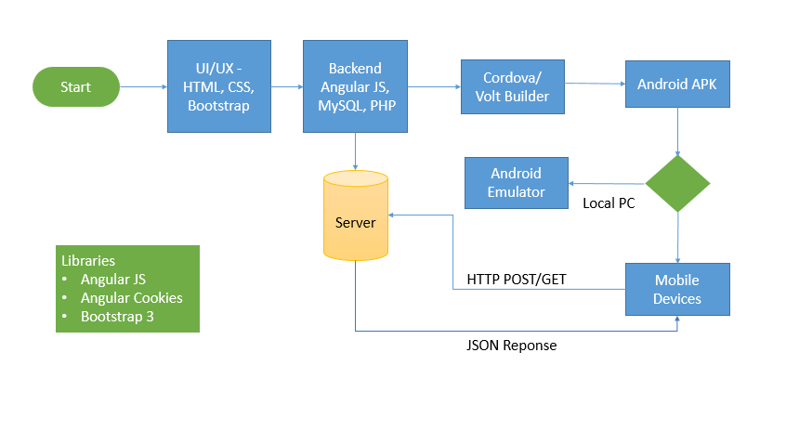
WORKFLOW DIAGRAM FOR ANDROID APPLICATION

Slide 15
CONCLUSION
Campus Placement and Recruitment for any college website/Application is very important.
Online Recruitment Management System can be used by employers to recruit the candidates based on their online test and the further interviews easily.
Achieving this objective is difficult using the manual system as the information is scattered, can be redundant and collecting relevant information may be very time-consuming. All these problems are solved by this project.
This system helps in maintaining the information of potential candidates at one place. It can be easily accessed by both (Students) applicant and employers
It reduces the time employer take to make few recruitments in their firm.
This system helps the job seekers to get every information required for the process.

Slide 16
FUTURE ENHANCEMENT
In Future work, This application to develop a cross platforms like IOS, etc
In proposed online job recruitment system there is scope for improvement of the system.
In the future we can place the system on the cloud so the maintenance of the data can be reduced.
The Exam system will integrate with the online placement system so the student result can get directly
There can be many more future Enhancement & improvement in the Online Placement System.

Slide 17
REFERNECES
Campus Portals : Vishwakrma VOLP Portal
Ceipal.com/applicant tracking software. (AI based all in one recruitment software)
The joy of PHP:A beginner’s guide, Head first PHP &MySql.
Google.com/php
ORACLE by Evan Bycross
HTML Black Book by Steven Holzner

